Slide 1
E-week 2020 kickoff
High School robotics competition
https://www.youtube.com/watch?v=Gd53rZs5fsY
https://www.youtube.com/watch?time_continue=165&v=pzZGvypreXQ

Slide 2
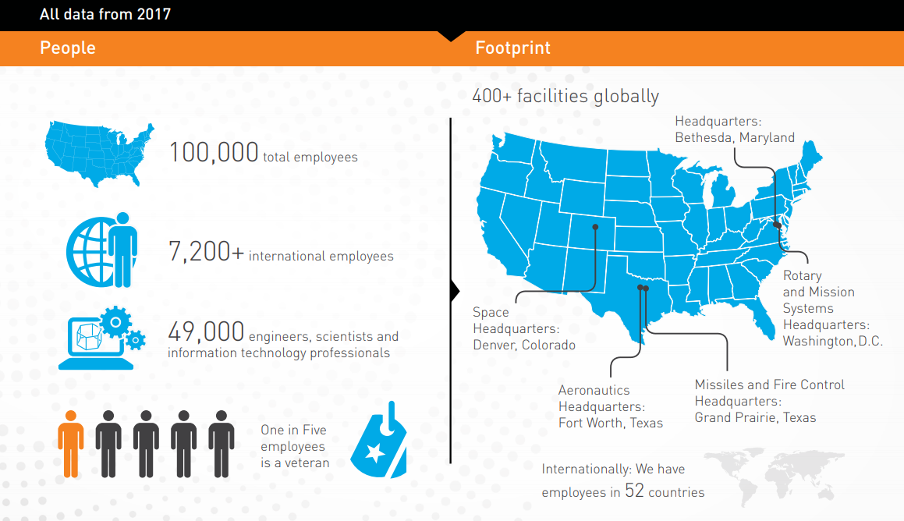
Who is Lockheed martin?

Slide 3

What does Lockheed martin do?

Slide 4
Engineering at Lockheed martin
Systems Engineering
~1,300 Engineers
Test Engineering
~300 Engineers
29%
7%
22%
10%
Software Engineering
~475 Engineers
14%
18%
Mechanical Engineering
~650 Engineers
Electrical Engineering
~800 Engineers

Slide 5
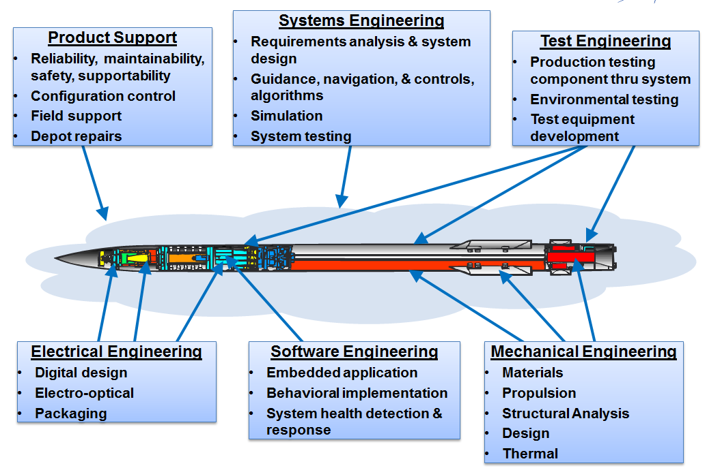
Typical roles

Slide 6
E-week competition basics
Compete against other local high schools to create the robot best suited for achieving the defined mission.
Your Lockheed Mentors will guide you through your mission as you learn about:
Engineering
Teamwork and Collaboration
Strategy
Financial Constraints
Trade Studies
Just to name a few!

Slide 7

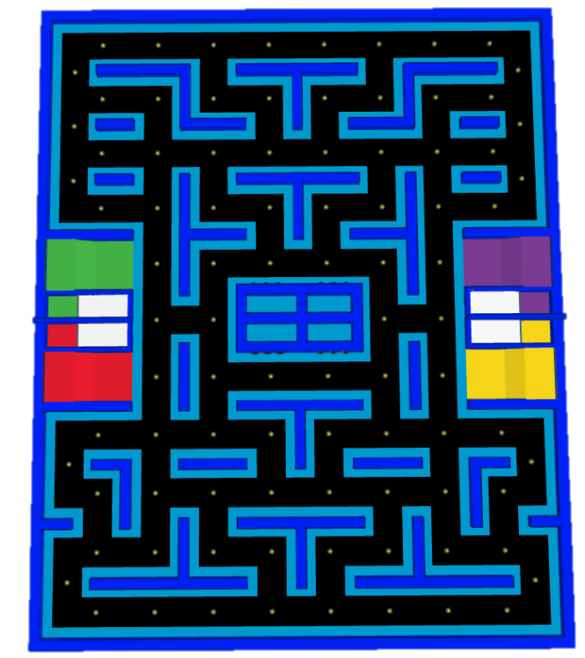

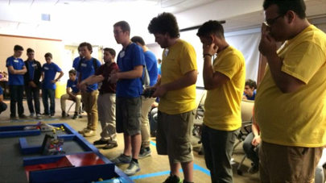
E-week 2017 competition

Slide 8

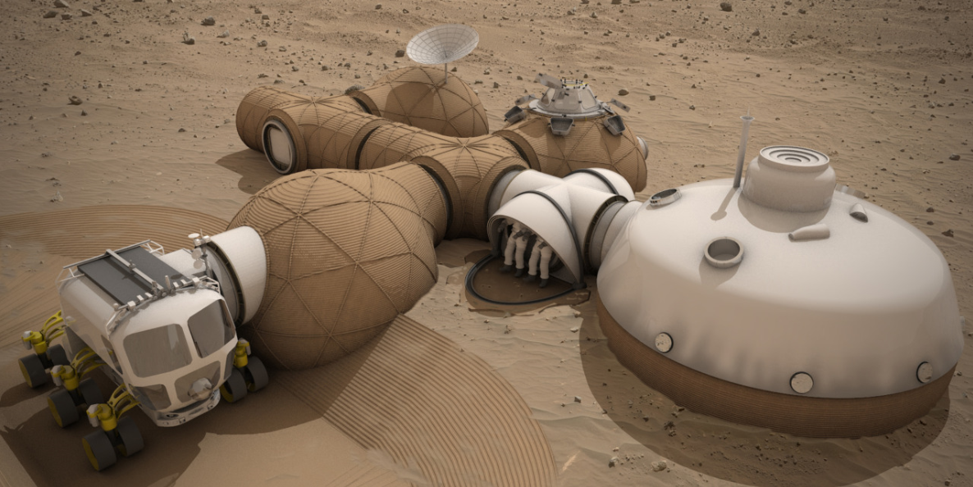
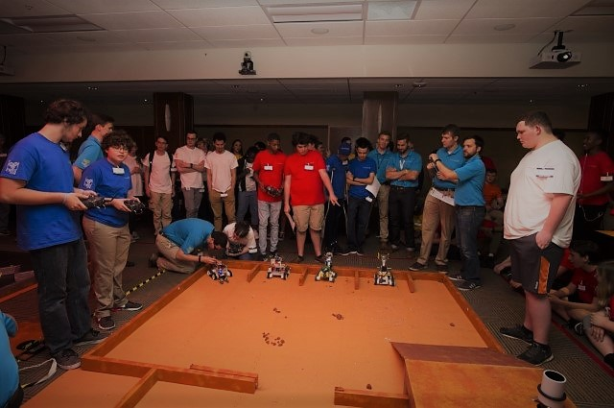
E-week 2018 competition

Slide 9
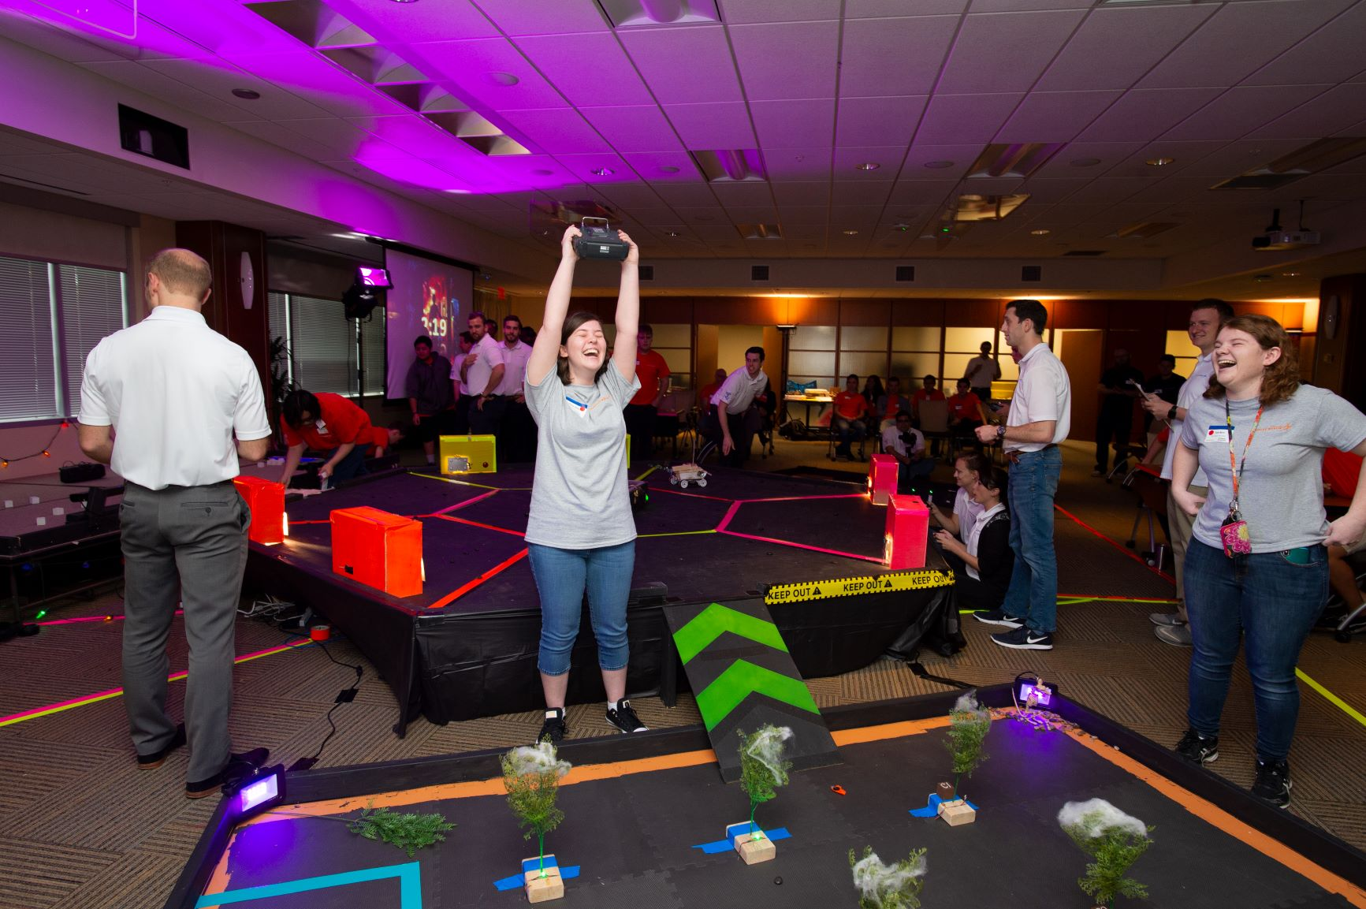

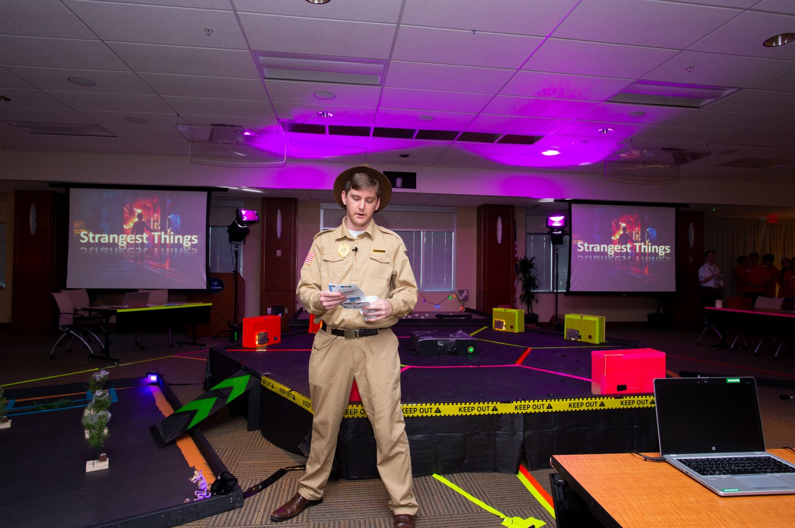
E-week 2019 competition
Strangest Things
Strangest Things

Slide 10
And the E-Week 2020 theme is…

Slide 11


THE INFINITY GAUNTLET
E-WEEK 2020

Slide 12


Theme: Defeat Thanos, Stop the Snappening
Captain America has recruited you to be a part of the Avengers Team. Help the Avengers even the odds against Thanos and collect all 6 Infinity Stones before it’s too late.

Slide 13
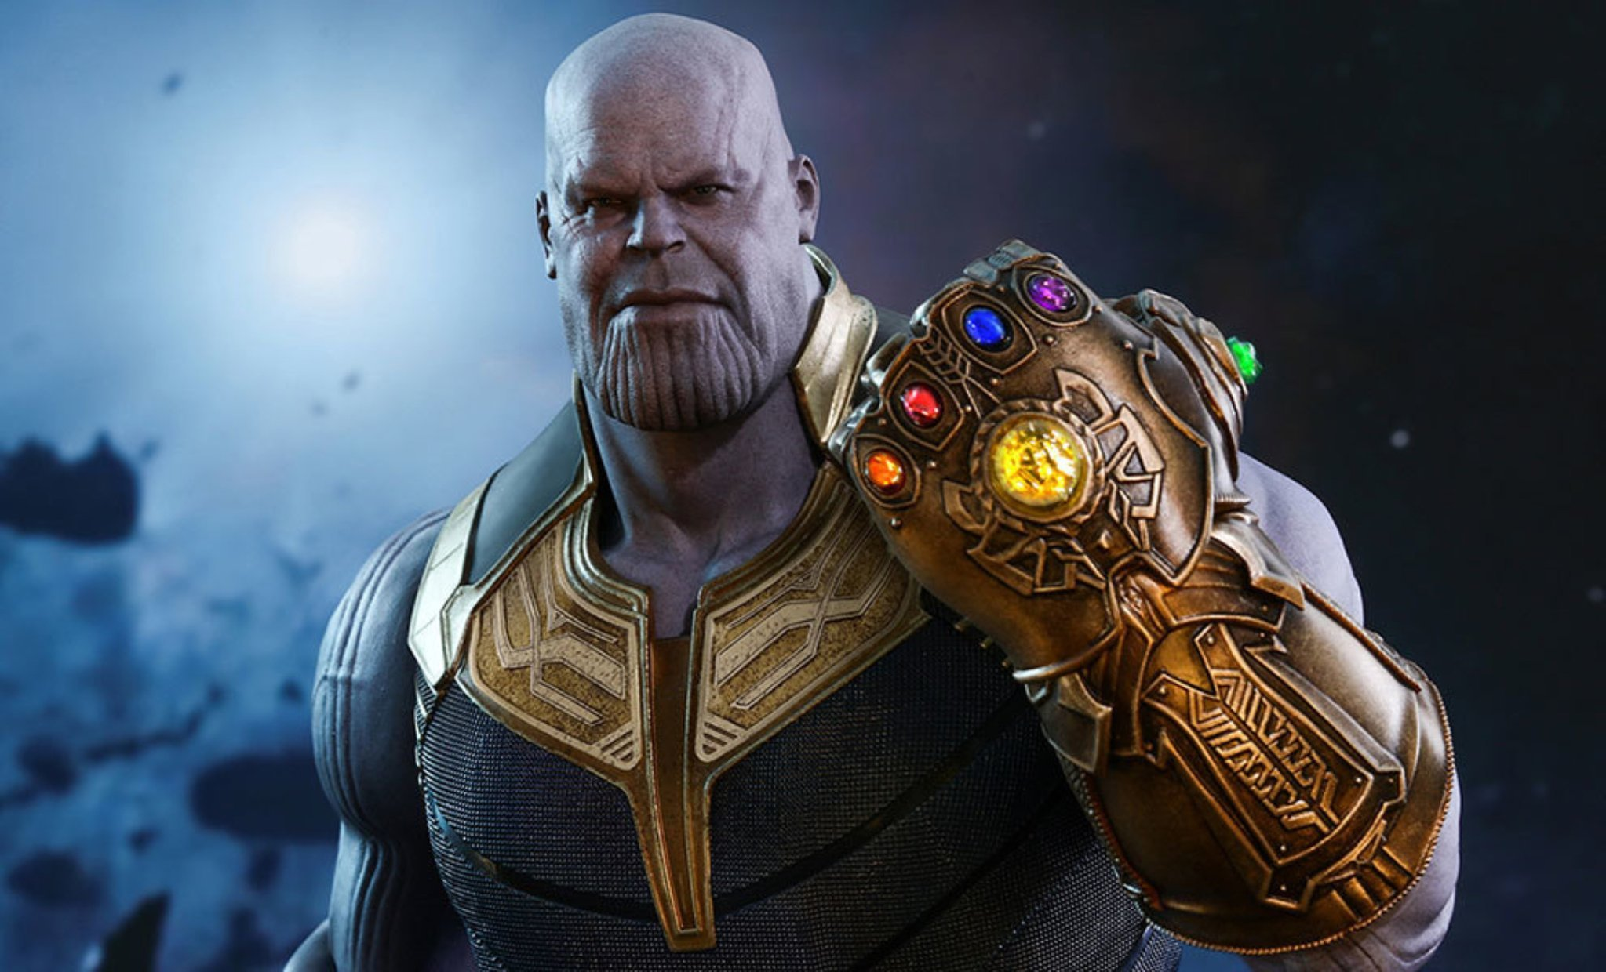
Con ops
The goal is to collect all six Infinity Stones in time to help stop Thanos
Three robots compete in separate rooms for every 7 minute round
The robots, with assistance from their challenge teams, will complete a set of tasks in each room
The more infinity stones a team collects, the more it will help them in the final battle with Thanos

Slide 14
Roles and course layout

Slide 15
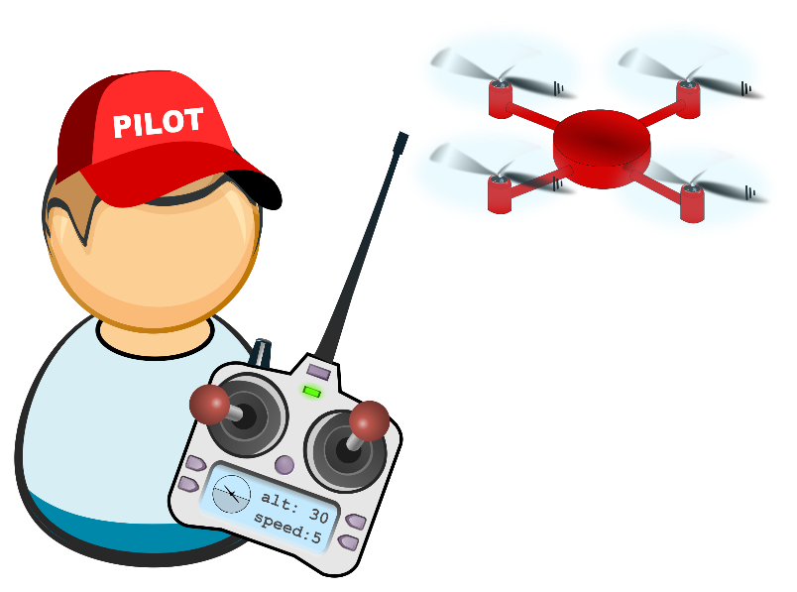


Team roles
Driver (1)
Mechanic/Helper (1)
Only one able to speak to judge/driver/challenge lead
Challenge Team (5-6)
Challenge Leader
Only one able to speak to the judges/mechanic
Helper

Slide 16
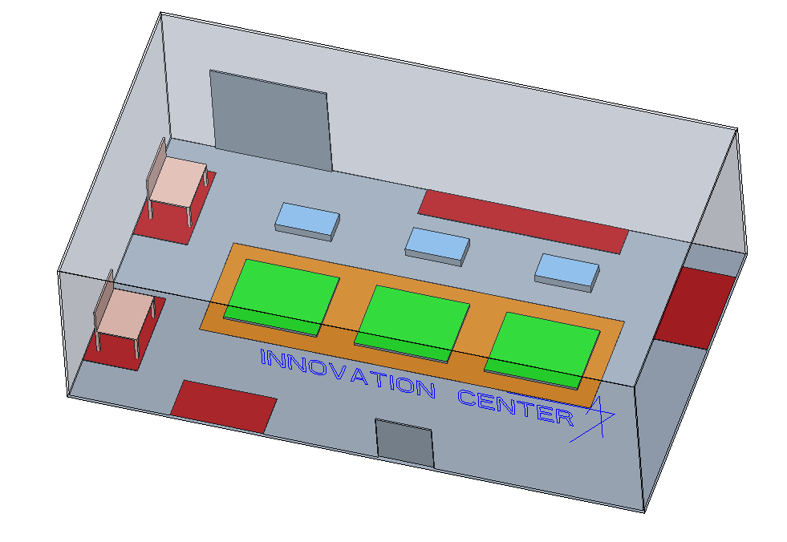
Basic course layout
Each room will be 10’ x 8’ with a walking path around the entirety
Two rooms will be combined to create a 10’ x 20’ championship round
Teams will have a work table to use between rounds for robot adjustments

Slide 17
Space and time
Zone 1
Robot
Zone 1
Navigate “New York” to reach all three magnetic switches
Actuate all three switches within the time limit to unlock the second room
Zone 2
Use IR sensor to detect the correct “Ancient One” and collect the Time Stone by returning to start
Challenge Team
Zone 1
Navigate the Quantum Realm using Cozmo
Solve trig problems and program them into Cozmo’s app to reach two checkpoints
Zone 2
Solve trig problem to identify the correct Tesseract and collect the Space Stone
Zone 2
Zone 1

Slide 18
Soul and reality (robot)
Navigate through Vormir and drop off your magnetic keys to Hawkeye and Black Widow
Drag the magnet through the plexiglass maze and drop one in each of the two drop zones
Unlock the door to the tower and collect the Soul Stone by flipping a magnetic switch

Slide 19

Soul and reality (Challenge)
Tony is busy working out the details of the Quantum Heist, but he needs help making an electromagnet!
A set length and gauge of insulated copper wire will be provided to you, but it’s up to you to optimize the design.
Create an electromagnet that will be powered by a battery to pick up as many paper clips as possible.
A successful design unlocks the Reality Stone, but the more you pick up the more points for your team.

Slide 20
Power and mind
Robot 1. Power Stone
Push weighted power source onto yellow block to provide “circuit” with power
Activate magnetic switch to collect the Power Stone
2. Mind Stone
Retrieve resistors (blocks with Ω values) from ramp area and place in appropriate empty slot of “circuit”
Activate magnetic switch to collect the Mind Stone
Challenge Team
Power: Answer power related questions to lessen weight robot has to push
Mind: Perform circuit analysis to determine which resistor values are placed where
Strategy: Which order should you answer questions to best help the robot?

Slide 21
championship round
Driver will be stationed near the Start, Spotter will be stationed near the Heroes
Push the gauntlet to the other side of the battle field – wt. varies based on previous performance
Identify Hero to rescue with IR sensor – quantity of decoys varies based on previous performance
Retrieve Hero with magnet and return to start – first team to complete all tasks wins

Slide 22
Scoring breakdown
Perfect Point Score (for all 3 rounds): 6,000 points
1,000 points per room for completing tasks
1,000 points per room for time

Slide 23
Bonus points
You could start competition day with up to 100 points!
Presentation
Pitch a Critical Design Review (CDR) to the Lockheed Martin mentoring team by January 31st to receive up to 50 points.
Sensor Demonstration
Demonstrate a functional IR sensor by February 7th to receive up to 50 points.

Slide 24
Judging / penalties
Judges
One judge for Mission Team and one judge for Challenge Team
Responsible for logging points, tracking time, and identifying/enforcing penalties
Penalties
No team member may enter the course
No extensive modifications to robot without consent from E-Week leadership
i.e. no permanent structural changes to the provided robot chassis/parts
No intentional/reckless course damage

Slide 25
DESIGN REQUIREMENTS

Slide 26

ROBOT KITS
Robot Kit Contains
Disassembled RC Car Kit (x1)
2200 mAh 3 Cell LiPo Battery (and charger) (x1)
Transmitter/Receiver Pair (x1)
Arduino/Cables (x1 set)
Motor Controller (x1)
Power Regulator (x1)
IR Sensor (x1)
Magnet (x2)
Copper Wire (5’)
Each team is responsible for procuring additional required parts for their robot ($100 maximum)
TRACK YOU BUDGET! It is required to compete and receive repayment.
LM Mentors will determine the value of reused items.

Slide 27
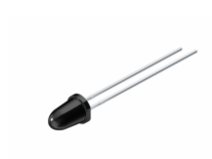

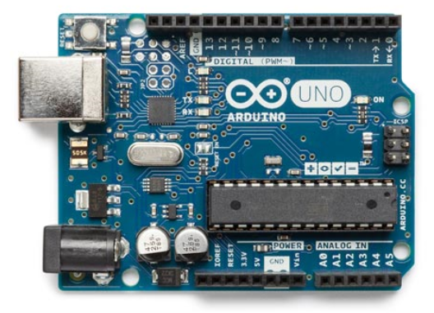
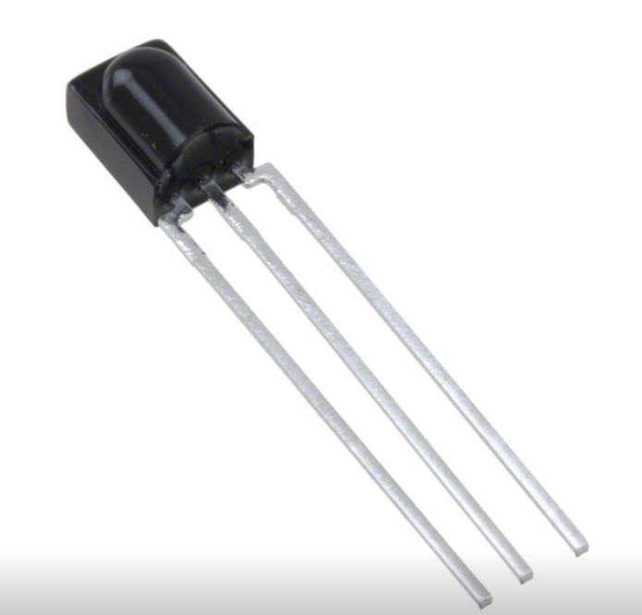
Sensors and actuation
Teams will need to integrate an IR receiver to an Arduino and output to a signaling device
Uses the same protocol as most TV remotes.
See Sparkfun tutorial here for more information.
Teams will need to use a magnet to actuate switches and pick up objects

Slide 28
SCHEDULE

Slide 29
DEVELOPMENT SCHEDULE

Slide 30
Concluding Remarks
Read the rules document carefully for clarification
Rules document takes precedent over this slide package
Questions or clarification on rules
All questions will be answered weekly
Don’t forget to ask your mentors to bring in Cozmo one week to familiarize yourself with the app interface.
Think about possible designs and strategies over the break!

